Slide 1
Investing in Stocks
12
12.1 Evaluating Stocks
12.2 Buying and Selling Stock

Slide 2
Schedule
Review Test
Scattegories
P.P.-Types of Stock
W.S. Different Types of Stocks
P.P.-Valuing Stock
P.P.-Stock Price and Indexes
Examples of Overvalued vs. Undervalued Stocks
Online Stock Game

Slide 3
Evaluating Stocks
GOALS
Describe features of stock and types of stocks.
Explain how to value a stock and decide a fair price to pay for a stock purchase.

Slide 4
Owning Stock
Nearly 50 million people in the United States own stocks.
People who own shares of stock are called stockholders, or shareholders, of the corporation.
Two ways to profit from owning stock:
  Dividends are money paid to stockholders from the corporation’s earnings (profits).
  Capital gain is an increase in the value of the stock over time.

Slide 5
Common Stock
Common stock represents a type of stock that pays a variable dividend and gives the holder voting rights.
A proxy is a stockholder’s written authorization to transfer his or her voting rights to someone else, usually a company manager.

Slide 6
Preferred Stock
Preferred stock represents a type of stock that pays a fixed dividend but has no voting rights.
Preferred stockholders earn the stated dividend, regardless of how the company is doing.
  Preferred stock is less risky than common stock.
  Dividends on preferred stock may be lower than common stockholders would earn, if the company is thriving over time.

Slide 7
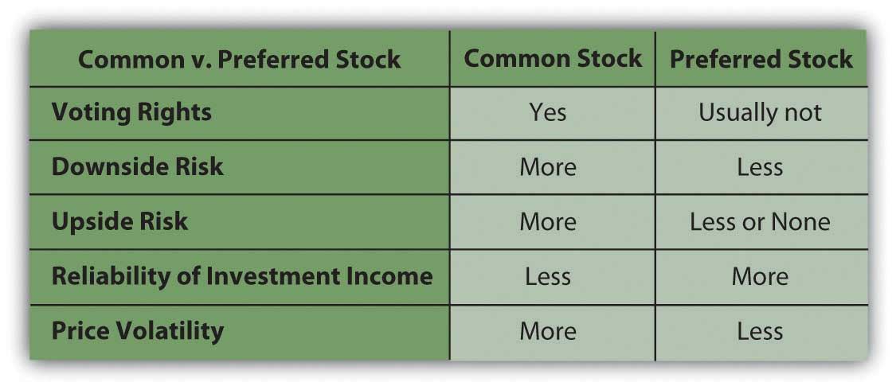
Common VS Preferred

Slide 8
Types of Stock Investments
Income stocks-
Growth stocks-
Emerging stocks-
Blue chip stocks-
Defensive stocks
Cyclical stocks-

Slide 9
W.S. Different Types of Stocks

Slide 10
Income Stocks and Growth Stocks
Income stocks are stocks that have a consistent history of paying high dividends.
Growth stocks are stocks in corporations that reinvest their profits into the business so that it can grow.

Slide 11
Emerging Stocks and Blue Chip Stocks
Emerging stocks are stocks in young, often small corporations that have higher overall risk than stocks of companies that have been successful for many years.
Blue chip stocks are stocks of large, well-established corporations with a solid record of profitability.

Slide 12
Defensive Stocks and Cyclical Stocks
A defensive stock, or non-cyclical stock, is one that remains stable and pays dividends during an economic decline.
Cyclical stocks do well when the economy is stable or growing but often do poorly during recessions, when the economy slows down.

Slide 13
Valuing Stock
Market value is the price for which the stock is bought and sold in the marketplace.

Slide 14
Stock Price
Factors that affect price include:
  The company
  Interest rates
  The market
  Earnings per share

Slide 15
Return on Investment
Because you can make money on stocks from dividends and from an increase in the price of the stock (capital gain), you should consider both when computing the return on your investment.
Your profit is the difference between what you paid for the stock and what you sold it for, plus any dividends you earned.
To compute the total costs, add any commission you paid to the stockbroker to the purchase price of the stock.

Slide 16
Stock Indexes
A stock index is a benchmark that investors use to judge the performance of their investments.
Examples of commonly used indexes include:
  Dow Jones Industrial Average
  Standard & Poor’s 500
  NASDAQ Composite Index

Slide 17
Go to thestreet.com
Find some overvalued and undervalued stocks and use them to purchase stock

Slide 18
Schedule
Review
P.P.-Bull Vs Bear
White board breakdowns-Types of Investing
Math Problems- Selling Short and Dollar-Cost Avg
Reading a stock listing in a newspaper
How the Market Works
HW: Read Sec 1 Chapter 14

Slide 19
Lesson 12.2
Buying and Selling Stock
GOALS
Describe the process of buying and selling stocks.
Describe short- and long-term investment strategies when buying and selling stocks.
Explain how to read the stock listings and stock indexes.

Slide 20
The Securities Market
A securities exchange is a marketplace where brokers who are representing investors meet to buy and sell securities.
The over-the-counter (OTC) market is a network of brokers who buy and sell the securities of corporations that are not listed on a securities exchange.

Slide 21
Bull and Bear Markets
A bull market is a prolonged period of rising stock prices and a general feeling of investor optimism.
A bear market is a prolonged period of falling stock prices and a general feeling of investor pessimism.

Slide 22
Investing Strategies
Short-term techniques
  Buy on margin
  Sell short
Long-term techniques
  Buy and hold
  Dollar-cost averaging
  Direct investment
  Reinvesting dividend

Slide 23
Buy on Margin
You can borrow money from your broker to buy stock if you open a margin account and sign a contract called a margin agreement.
Leverage is the use of borrowed money to buy securities.
When the market value of a margined stock decreases to approximately one-half of the original purchase price, the investor will receive a margin call from the broker.
This means the investor must pledge additional cash or securities to serve as collateral for the loan.

Slide 24
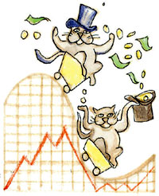
Sell Short
Short selling is selling stock borrowed from a broker that must be replaced at a later time.
To sell short, you borrow a certain number of shares from the broker.
You then sell the borrowed stock, knowing that you must buy it back later and return it to the broker.
You are betting that the price will drop, so that you can buy it back at a lower price than you sold it for, thus making a profit.

Slide 25
Long-Term Investing Techniques
Buy and hold
Dollar-cost averaging
Direct investment
Reinvesting dividends

Slide 26
Buy and Hold
Most investors consider stock purchases as long-term investments.
All stocks go up and down, but over a number of years, the overall trend of non-speculative stocks is moderately up.
If you “buy and hold” stocks for many years, you can ride out the down times.
When you are ready to sell years later, most likely your stock will have gained value.
In addition, many stocks pay dividends, so you are earning income while you hold the stock.

Slide 27
Dollar-cost Averaging
The dollar-cost averaging technique involves the systematic purchase of an equal dollar amount of the same stock at regular intervals.
The result is usually a lower average cost per share.

Slide 28
Direct Investment
You can save money using direct investment, or buying stock directly from a corporation.
  By buying directly, you avoid brokerage and other purchasing fees.
  You may also be able to obtain shares at prices lower than on open exchanges.

Slide 29
Reinvesting Dividends
Dividend reinvestment means using dividends previously earned on the stock to buy more shares.
Buying stock this way avoids a broker fee and other costs that apply, such as taxes, when you receive cash dividends on the stock.

Slide 30
Reading the Stock Listings
Excerpt from stock exchange listings:
52 Wks |  | Stock | Div | Yld% | P/E Ratio | Sales 100s | High | Low | Close | Net Change
High | Low
1 | 2 | 3 | 4 | 5 | 6 | 7 | 8 | 9 | 10 | 11
58.75 | 44.00 | Enger | 2.20 | 4.8 | 12 | 109 | 46.38 | 45.50 | 46.00 | –.50
45.00 | 23.00 | Eng pf | 2.25 | 8.9 | 10 | 25 | 26.25 | 24.00 | 25.38 | +.38
10.50 | 9.00 | Entld | .10 | 1.0 | 3 | 8 | 10.13 | 9.50 | 10.00 | ----
24.00 | 16.00 | Epsco | 1.00 | 5.0 | 7 | 12 | 21.00 | 19.00 | 20.00 | +.88
6.38 | 4.00 | Exlab | ---- | ---- | 15 | 300z | 5.75 | 5.12 | 5.50 | ----
57.00 | 32.00 | ExeB | 2.50 | 5.7 | 11 | 48 | 46.00 | 43.00 | 44.00 | +1.00

Slide 31
Investing in Mutual Funds, Real Estate, and Other Choices
14
14.1 Investing in Mutual Funds

Slide 32
Schedule
King of the Hill
Types of Funds W.S.
Morningstar Fund Research
How the Market Works Game- Buying mutual funds
401k Research
HW: None

Slide 33
Lesson 14.1
Investing in Mutual Funds
GOALS
Discuss mutual funds as an investment strategy.
Explain how to buy and sell mutual funds.

Slide 34
Mutual Funds
A mutual fund is a professionally managed group of investments bought using a pool of money from many investors.
Individuals buy shares in the mutual fund.
The fund managers use this pooled money to buy stocks, bonds, and other securities.
The kinds of securities they buy depend on the fund’s stated investment objectives.

Slide 35
Advantages of Mutual Funds
Professionally managed
Liquid
Diversified
Require only a small minimum investment

Slide 36
Mutual Fund
Growth funds-
Income funds-
Growth and income funds-
Money market funds-
Global funds-
Index funds-

Slide 37
Growth Funds
A growth fund is a mutual fund whose investment goal is to buy stocks that will increase in value over time.

Slide 38
Income Funds
An income fund is a mutual fund whose investment goal is to produce current income in the form of interest or dividends.

Slide 39
Growth and Income Funds
A growth and income fund is a mutual fund whose investment goal is to earn returns from both dividends and capital gains.
  A balanced fund is a mutual fund that seeks both growth and income but attempts to minimize risk by investing in a mixture of stocks and bonds rather than stocks alone.

Slide 40
Money Market Funds
A money market fund is a mutual fund that invests in safe, liquid securities, such as Treasury Bills and bonds that mature in less than a year.

Slide 41
Global Funds
A global fund is a mutual fund that purchases international stocks and bonds as well as U.S. securities.

Slide 42
Index Funds
An index is an average of the price movements of certain selected securities.
Investors use indexes as benchmarks for comparison to judge how well their investments are doing.
An index fund is a mutual fund that tries to match the performance of a particular index by investing in the companies included in that index.

Slide 43
Risk and Return Pyramid
Higher risk/higher
return potential
Growth
Funds
Growth and
Income Funds
Income Funds
Lower risk/lower
return potential
Money Market Funds

Slide 44
The Prospectus
The prospectus is a legal document that offers securities or mutual fund shares for sale.
It must contain the following:
  The terms
  A summary of the fund’s portfolio of investments
  The fund’s objectives
  Financial statements showing past performance

Slide 45
Costs and Fees
If you buy a mutual fund through a broker, you will likely have to pay a sales fee, called a load.
  Front-end load
  Back-end load
  No-load fund

Slide 46
The Mutual Fund Company
You have no guarantees that a mutual fund will make money or that the mutual fund company itself will not fail.
To reduce these risks, choose a mutual fund company that has the following characteristics:
  It has been in business for 20 or more years
  It has a solid track record of returning good solid returns to investors
  It is a large company that manages investments for millions of investors
  It is a well-known company that is highly respected among investment advisers and experts
  It exists both in brick-and-mortar and in cyberspace
  It is customer friendly and responsive to customer questions and needs
  It provides customers with easy-to-read statements and reports and offers daily online access

Slide 47
Schedule
401 K Research and review
2 Truths and Lie
HW: None

Slide 48
Lesson 14.1
Investing in Mutual Funds
GOALS
Discuss mutual funds as an investment strategy.
Explain how to buy and sell mutual funds.

Slide 49





Who or what is the text about? | 2. What connection does this text have to our class? | 3. What questions do you have about the text?
4. Are there any words or terms that you don’t understand or are curious about? |  | 5. What are comments or quotes that you found most interesting from the text

